Slide 1
Chapter 10
One- and Two-Sample Tests of Hypotheses

Slide 2

What is a Hypothesis?
A hypothesis is a claim
(assumption), statement about a
population parameter:
  population mean
  population proportion
Example: The mean monthly cell phone bill of this city is μ = $42
Example: The proportion of adults in this city with cell phones is π = 0.68

Slide 3
Hypothesis testing
Hypothesis testing
A process which enable us to decide on the basis of information from sample whether to accept or reject a statement about the value of population parameter.

Slide 4
Example
Literacy rate in Pakistan is less than 30%.
Average family size in Pakistan is more than 4 persons.
The average monthly income of public and private servants is different.
The average rainfall in the month of march is1.3 inches.

Slide 5
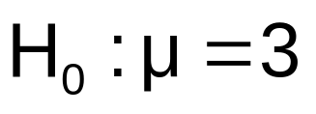

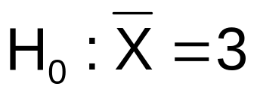
The Null Hypothesis, H₀
States the claim or assertion to be tested
  Example: The average number of TV sets in U.S. Homes is equal to three ( )
Is always about a population parameter, not about a sample statistic

Slide 6
The Null Hypothesis, H₀
(continued)
Begin with the assumption that the null hypothesis is true
  Similar to the notion of innocent until
  proven guilty
Always contains “=” , “≤” or “≥” sign
May or may not be rejected

Slide 7
The Alternative Hypothesis, H₁
Is the opposite of the null hypothesis
  e.g., The average number of TV sets in U.S. homes is not equal to 3 ( H₁: μ ≠ 3 )
Challenges the status quo
Never contains the “=” , “≤” or “≥” sign
May or may not be proven
Is generally the hypothesis that the researcher is trying to prove

Slide 8
Hypothesis Testing Process
Claim: the
population
mean age is 50.
(Null Hypothesis:
Population
H₀: μ = 50 )
Now select a random sample
X
Is
=
20
likely if μ = 50?
If not likely,
Suppose
the sample
REJECT
mean age
is 20: X = 20
Sample
Null Hypothesis

Slide 9
Reason for Rejecting H₀
Sampling Distribution of X
X
20
μ = 50
If H₀ is true
... then we reject the null hypothesis that μ = 50.
If it is unlikely that we would get a sample mean of this value ...
... if in fact this were
the population mean…

Slide 10
Level of Significance, α
Defines the unlikely values of the sample statistic if the null hypothesis is true
  Defines rejection region of the sampling distribution
Is designated by α , (level of significance)
  Typical values are 0.01, 0.05, or 0.10
Is selected by the researcher at the beginning
Provides the critical value(s) of the test

Slide 11
Level of Significance and the Rejection Region
Level of significance =
α
Represents
critical value
H₀: μ = 3 H₁: μ ≠ 3
α
α
/2
/2
Rejection region is shaded
Two-tail test
0
H₀: μ ≤ 3 H₁: μ > 3
α
Upper-tail test
0
H₀: μ ≥ 3 H₁: μ < 3
α
Lower-tail test
0

Slide 12
Errors in Making Decisions
Type I Error
  Reject a true null hypothesis
  Considered a serious type of error
  The probability of Type I Error is α
    Called level of significance of the test
    Set by the researcher in advance

Slide 13
Errors in Making Decisions
(continued)
Type II Error
  Fail to reject a false null hypothesis
  The probability of Type II Error is β

Slide 14
Outcomes and Probabilities
Possible Hypothesis Test Outcomes
Actual Situation
Decision
H₀ True
H₀ False
Do Not
No error
(1 - )
Type II Error
( β )
Reject
Key:
Outcome
(Probability)
α
H
0
Reject
Type I Error
( )
No Error
( 1 - β )
H
α
0

Slide 15
Hypothesis Tests for the Mean
Hypothesis
Tests for μ
σ Known
σ Unknown
(Z test)
(t test)

Slide 16
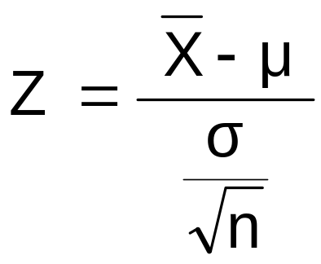
Z Test of Hypothesis for the Mean (σ Known)
Convert sample statistic ( ) to a Z test statistic
X
Hypothesis
Tests for μ
σ Known
σ Known
σ Unknown
σ Unknown
(Z test)
(t test)
The test statistic is:

Slide 17

Critical Value
Approach to Testing
For a two-tail test for the mean, σ known:
Convert sample statistic ( ) to test statistic (Z statistic )
Determine the critical Z values for a specified
level of significance α from a table or computer
Decision Rule: If the test statistic falls in the rejection region, reject H₀ ; otherwise do not reject H₀

Slide 18
Two-Tail Tests
H₀: μ = 3 H₁: μ ≠ 3
There are two cutoff values (critical values), defining the regions of rejection
α/2
α/2
3
X
Reject H₀
Do not reject H₀
Reject H₀
-Z
+Z
Z
0
Lower critical value
Upper critical value

Slide 19
6 Steps in
Hypothesis Testing
State the null hypothesis, H₀ and the alternative hypothesis, H₁
Choose the level of significance, α, and the sample size, n
Determine the appropriate test statistic and sampling distribution
Determine the critical values that divide the rejection and nonrejection regions

Slide 20
6 Steps in
Hypothesis Testing
(continued)
Collect data and compute the value of the test statistic
Make the statistical decision and state the managerial conclusion. If the test statistic falls into the nonrejection region, do not reject the null hypothesis H₀. If the test statistic falls into the rejection region, reject the null hypothesis. Express the managerial conclusion in the context of the problem

Slide 21
Hypothesis Testing Example
Test the claim that the true mean # of TV sets in US homes is equal to 3.
(Assume σ = 0.8)
1. State the appropriate null and alternative
hypotheses
  H₀: μ = 3 H₁: μ ≠ 3 (This is a two-tail test)
2. Specify the desired level of significance and the sample size
  Suppose that α = 0.05 and n = 100 are chosen for this test

Slide 22
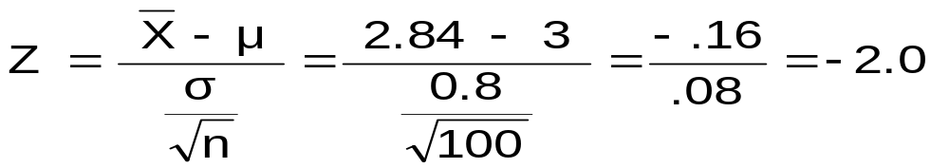
Hypothesis Testing Example
(continued)
3. Determine the appropriate technique
  σ is known so this is a Z test.
4. Determine the critical values
  For α = 0.05 the critical Z values are ±1.96
5. Collect the data and compute the test statistic
  Suppose the sample results are
  n = 100, X = 2.84 (σ = 0.8 is assumed known)
  So the test statistic is:

Slide 23
Hypothesis Testing Example
(continued)
6. Is the test statistic in the rejection region?
α = 0.05/2
α = 0.05/2
Reject H₀ if Z < -1.96 or Z > 1.96; otherwise do not reject H₀
Reject H₀
Do not reject H₀
Reject H₀
-Z= -1.96
0
+Z= +1.96
Here, Z = -2.0 < -1.96, so the test statistic is in the rejection region

Slide 24
Hypothesis Testing Example
(continued)
6(continued). Reach a decision and interpret the result
α = 0.05/2
α = 0.05/2
Reject H₀
Do not reject H₀
Reject H₀
-Z= -1.96
0
+Z= +1.96
-2.0
Since Z = -2.0 < -1.96, we reject the null hypothesis and conclude that there is sufficient evidence that the mean number of TVs in US homes is not equal to 3

Slide 25
p-Value Approach to Testing
p-value: Probability of obtaining a test statistic more extreme ( ≤ or ≥ ) than the observed sample value given H₀ is true
  Also called observed level of significance
  Smallest value of α for which H₀ can be rejected

Slide 26
p-Value Approach to Testing
(continued)
Convert Sample Statistic (e.g., ) to Test Statistic (e.g., Z statistic )
Obtain the p-value from a table or computer
Compare the p-value with α
  If p-value < α , reject H₀
  If p-value ≥ α , do not reject H₀
X

Slide 27
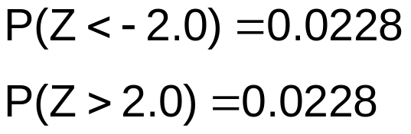
p-Value Example
Example: How likely is it to see a sample mean of 2.84 (or something further from the mean, in either direction) if the true mean is μ = 3.0?
X = 2.84 is translated to a Z score of Z = -2.0
α/2 = 0.025
α/2 = 0.025
0.0228
0.0228
p-value
= 0.0228 + 0.0228 = 0.0456
-1.96
0
1.96
Z
-2.0
2.0

Slide 28
p-Value Example
(continued)
Compare the p-value with α
  If p-value < α , reject H₀
  If p-value ≥ α , do not reject H₀
Here: p-value = 0.0456
α = 0.05
Since 0.0456 < 0.05, we reject the null hypothesis
α/2 = 0.025
α/2 = 0.025
0.0228
0.0228
-1.96
0
1.96
Z
-2.0
2.0

Slide 29
One-Tail Tests
In many cases, the alternative hypothesis focuses on a particular direction
This is a lower-tail test since the alternative hypothesis is focused on the lower tail below the mean of 3
H₀: μ ≥ 3
H₁: μ < 3
H₀: μ ≤ 3
H₁: μ > 3
This is an upper-tail test since the alternative hypothesis is focused on the upper tail above the mean of 3

Slide 30
Lower-Tail Tests
H₀: μ ≥ 3
H₁: μ < 3
There is only one critical value, since the rejection area is in only one tail
α
Reject H₀
Do not reject H₀
Z
-Z
0
μ
X
Critical value

Slide 31
Upper-Tail Tests
H₀: μ ≤ 3
H₁: μ > 3
There is only one critical value, since the rejection area is in only one tail
α
Z
Do not reject H₀
Reject H₀
0
Z_{α}
_
X
μ
Critical value

Slide 32
Example: Upper-Tail Z Test for Mean (σ Known)
A phone industry manager thinks that customer monthly cell phone bills have increased, and now average over $52 per month. The company wishes to test this claim. (Assume σ = 10 is known)
Form hypothesis test:
H₀: μ ≤ 52 the average is not over $52 per month
H₁: μ > 52 the average is greater than $52 per month
(i.e., sufficient evidence exists to support the
manager’s claim)

Slide 33
Example: Find Rejection Region
(continued)
Suppose that α = 0.10 is chosen for this test
Find the rejection region:
Reject H₀
α = 0.10
Do not reject H₀
Reject H₀
0
1.28
Reject H₀ if Z > 1.28

Slide 34
Review:
One-Tail Critical Value
Standardized Normal Distribution Table (Portion)
What is Z given α = 0.10?
0.90
0.10
.08
Z
.07
.09
α = 0.10
1.1
.8790
.8810
.8830
0.90
1.2
.8980
.8997
.9015
z
0
1.28
1.3
.9147
.9162
.9177
Critical Value
= 1.28

Slide 35
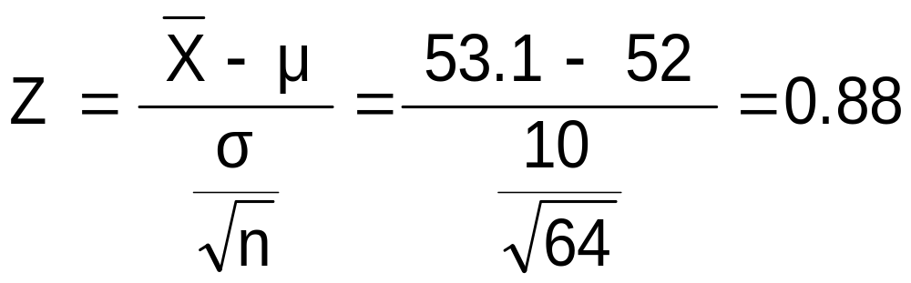
Example: Test Statistic
(continued)
Obtain sample and compute the test statistic
Suppose a sample is taken with the following results: n = 64, X = 53.1 (σ=10 was assumed known)
  Then the test statistic is:

Slide 36
Example: Decision
(continued)
Reach a decision and interpret the result:
Reject H₀
α = 0.10
Do not reject H₀
1.28
Reject H₀
0
Z = 0.88
Do not reject H₀ since Z = 0.88 ≤ 1.28
i.e.: there is not sufficient evidence that the
mean bill is over $52

Slide 37
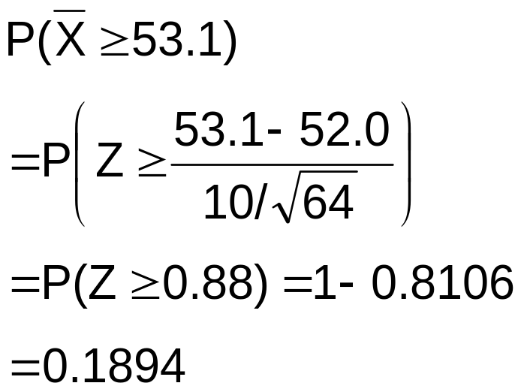
p -Value Solution
(continued)
Calculate the p-value and compare to α
(assuming that μ = 52.0)
p-value = 0.1894
Reject H₀
α = 0.10
0
Do not reject H₀
1.28
Reject H₀
Z = 0.88
Do not reject H₀ since p-value = 0.1894 > α = 0.10

Slide 38
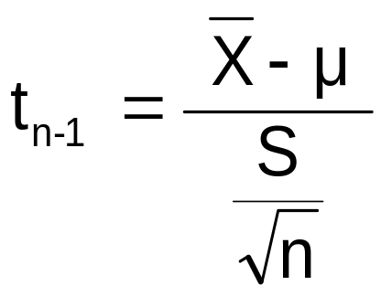
t Test of Hypothesis for the Mean (σ Unknown)
Convert sample statistic ( ) to a t test statistic
X
Hypothesis
Tests for μ
σ Known
σ Known
σ Unknown
σ Unknown
(Z test)
(t test)
The test statistic is:

Slide 39

Example: Two-Tail Test
(σ Unknown)
The average cost of a hotel room in New York is said to be $168 per night. A random sample of 25 hotels resulted in X = $172.50 and
S = $15.40. Test at the
α = 0.05 level.
(Assume the population distribution is normal)
H₀: μ = 168 H₁: μ ≠ 168

Slide 40
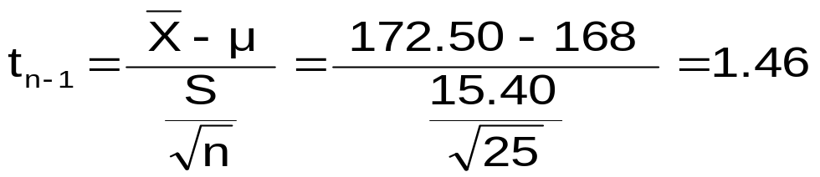
Example Solution:
Two-Tail Test
H₀: μ = 168 H₁: μ ≠ 168
α/2=.025
α/2=.025
α = 0.05
n = 25
σ is unknown, so
use a t statistic
Critical Value:
t₂₄ = ± 2.0639
Reject H₀
Do not reject H₀
Reject H₀
-t _{n-1,α/2}
t _{n-1,α/2}
0
-2.0639
2.0639
1.46
Do not reject H₀: not sufficient evidence that true mean cost is different than $168

